Slide 1
CSS7000 - INTERNSHIP Review- Presentation MediAssist AI – Intelligent Patient Platform
Student Details
Name | H NIKHITHA
Roll No | 20241CIT0121
Section | 5CIT02
Under the Supervision of,
Ms.Pushpalatha M
Assistant Professor
Presidency School of Artificial Intelligence & Advanced Computing
Presidency University
Name of the Program: B.Tech CSE (Internet of Things)
Name of the HoD:Dr. Sampath A K
Name of the Program Internship Coordinator: Mr. Francis Vijaykumar Annareddy
Name of the School Internship Coordinator: Dr. Geetha Arjunan

Slide 2
Content
About Company or Organization
Working domain or the technology
About your team and reporting Manager
Challenges Faced in Internship
Objectives of the work
Internship Roadmap
Github Link

Slide 3
About Company or Organization
NVIDIA Corporation
The internship was carried out in association with NVIDIA, a global technology company widely recognised for its work in accelerated computing, graphics processing and artificial intelligence.
NVIDIA provides hardware and software platforms that support demanding computational workloads and has played a major role in the growth of modern AI and deep-learning applications.
The company environment provided a relevant context for understanding how AI technologies move from research concepts to practical software systems.

Slide 4
NVIDIA and Artificial Intelligence
NVIDIA Corporation was founded in 1993 and is headquartered in Santa Clara, California. The company is best known for developing graphics processing units (GPUs).
Its technology portfolio has expanded substantially into accelerated computing, artificial intelligence, data centres, robotics, autonomous systems and scientific computing.
NVIDIA GPUs are widely used for parallel computation, making them particularly suitable for machine-learning workloads in which large numbers of mathematical operations must be performed efficiently

Slide 5
Organisational and Reporting Structure
The connection between the internship and NVIDIA is particularly relevant from a technical-learning perspective
Mediassist AI required an understanding of computer vision, deep learning, Python programming and model deployment. These areas are closely related to accelerated computing and AI engineering.
Working on the project therefore provided practical exposure to the stages involved in transforming an AI model into an end-user application rather than treating the neural network as an isolated academic experiment.

Slide 6
Working domain or the technology
Artificial Intelligence (AI) – for intelligent healthcare assistance
Machine Learning (ML) – for symptom analysis/classification, if implemented
Natural Language Processing (NLP) – for medical report summarization
Computer Vision – for skin and eye image screening
Python – for backend/AI development, if your project is Python-based
Web technology/UI framework – for the patient interface, depending on your actual project

Slide 7
About your team and reporting Manager
internship completed at NVIDIA, with technical direction on-site and academic review from the Presidency University guide and coordinators.
Reporting to: Mr. Francis Vijaykumar Annareddy; Academically:Ms.Pushpalatha M assiante Professor, PSAIAC (Internship Guide).
Coordination: Progress reviewed periodically with Mr. Francis Vijaykumar Annareddy and Dr. Geetha Arjunan (Internship Coordinators).
Working style:Healthcare & Artificial Intelligence (AI)
Technology: AI, NLP, Computer Vision, Python

Slide 8
Challenges Faced in Internship
TensorFlow/Python compatibility: Initial installation issues due to Python version mismatch; resolved by standardising on Python 3.12.
Large trained model file: The ~128 MB .keras model exceeded GitHub's 100 MB limit; solved by adopting Git LFS.
Grad-CAM explainability: Compatibility issues accessing intermediate CNN layer outputs; feature deferred to future work rather than shipped unstable.
Consistent preprocessing: Ensuring the Flask backend applied the exact same resize/array/normalise steps used during training.

Slide 9
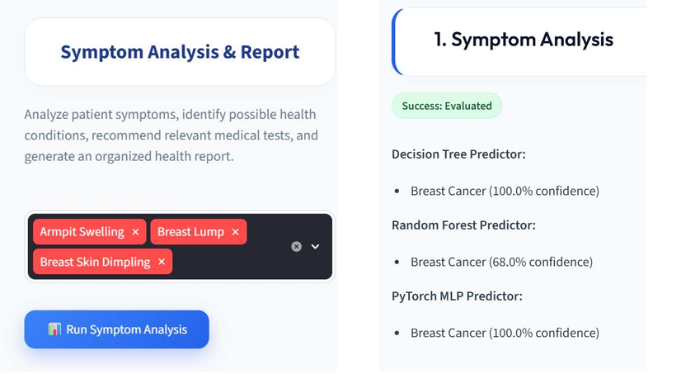

Slide 10
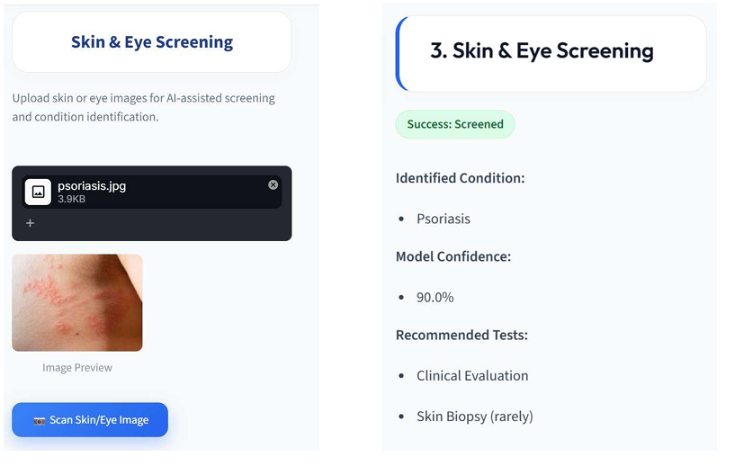
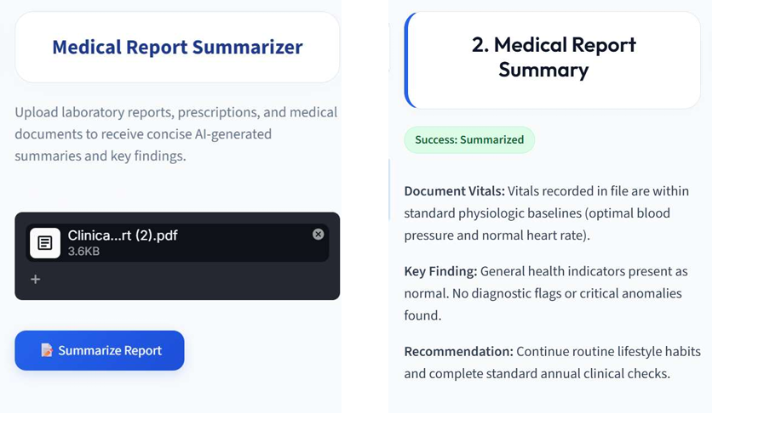
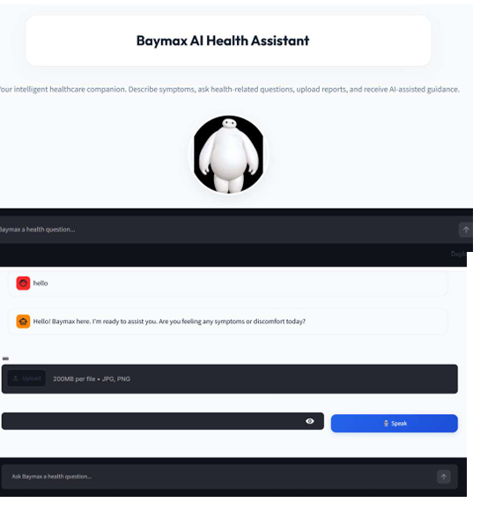

Slide 11
Github Link
https://github.com/coderbeach/MedAssistAI.git

